Slide 1
S.B.S. Govt. P.G. College
B.Ed. Department
Session From 2021-2023

Slide 2
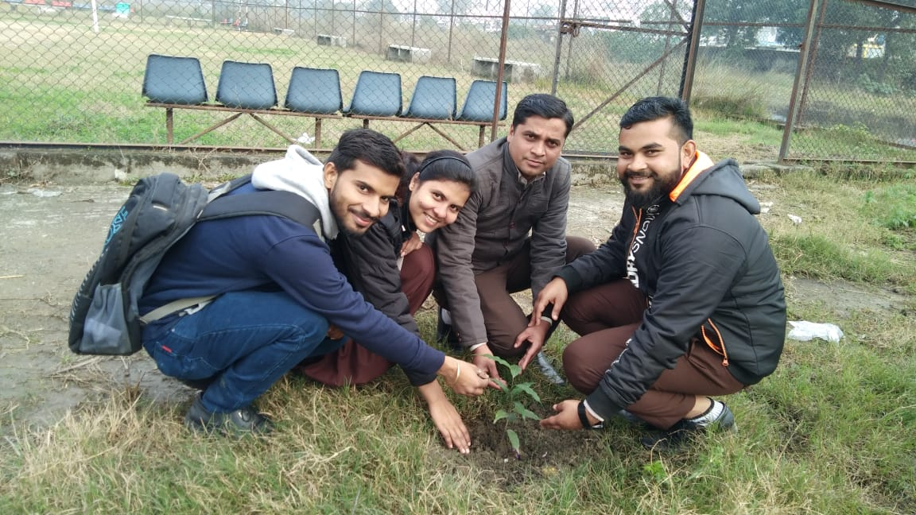
5 June,2022
WORLD ENVIRONMENT DAY
In the series of programs and activities during the session 2021-2022 started with the proper plantation on World Environment Day on June 5, 2021 following the title of ‘Clean Campus and Green Campus’.

Slide 3
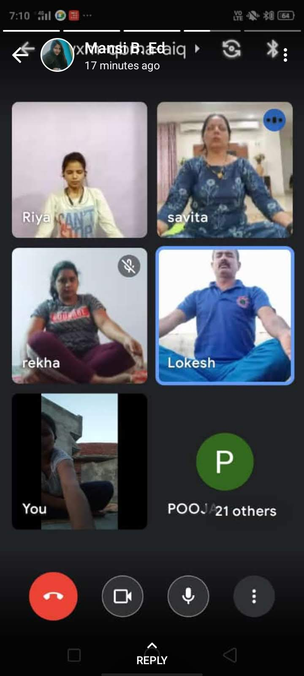
21, June, 2021
INTERNATIONAL YOGA DAY
On June 21, 2021 International Yoga Day celebrated by the department through google meet due to COVID- 19 following different Ashans, Pranayam etc. In this sequence 75th Independence Day was celebrated

Slide 4
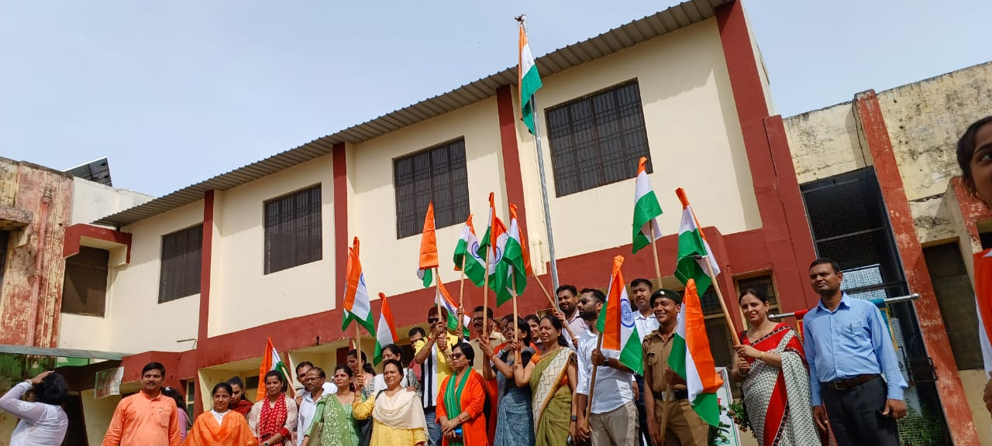
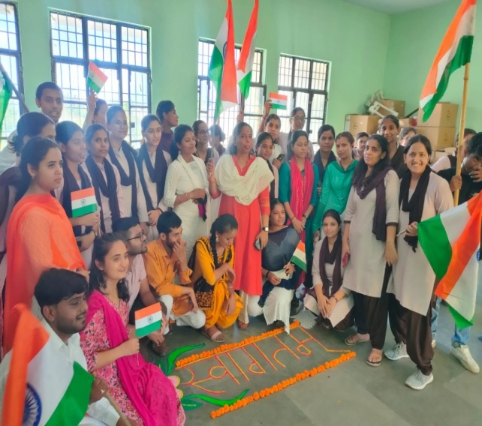
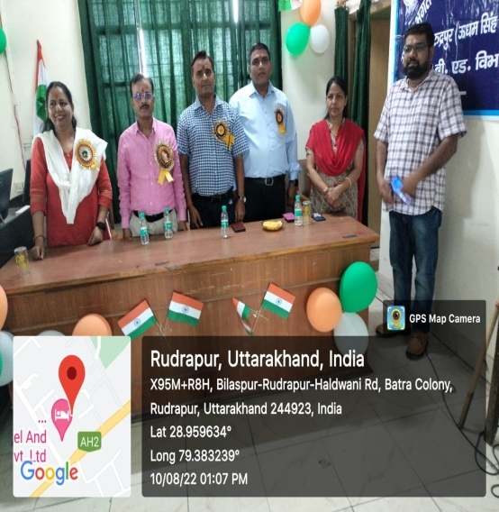
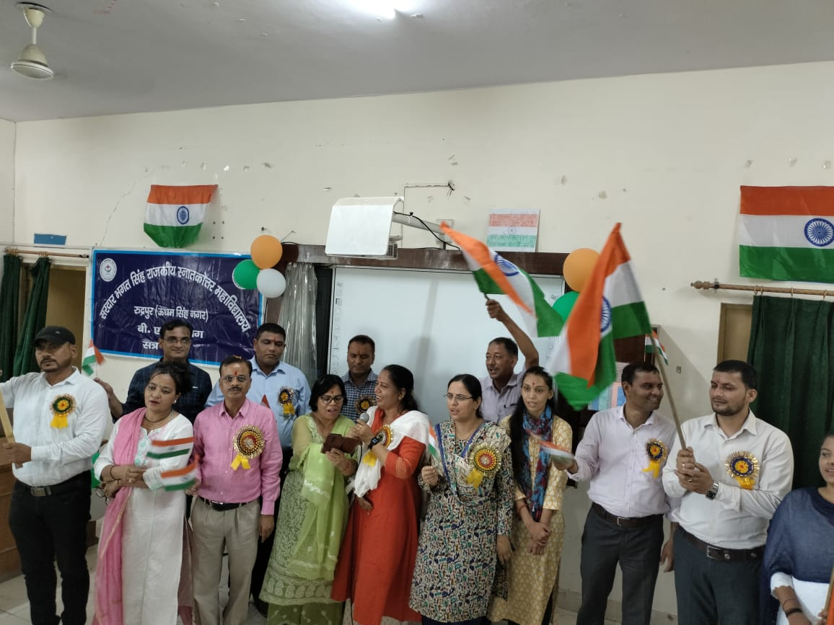
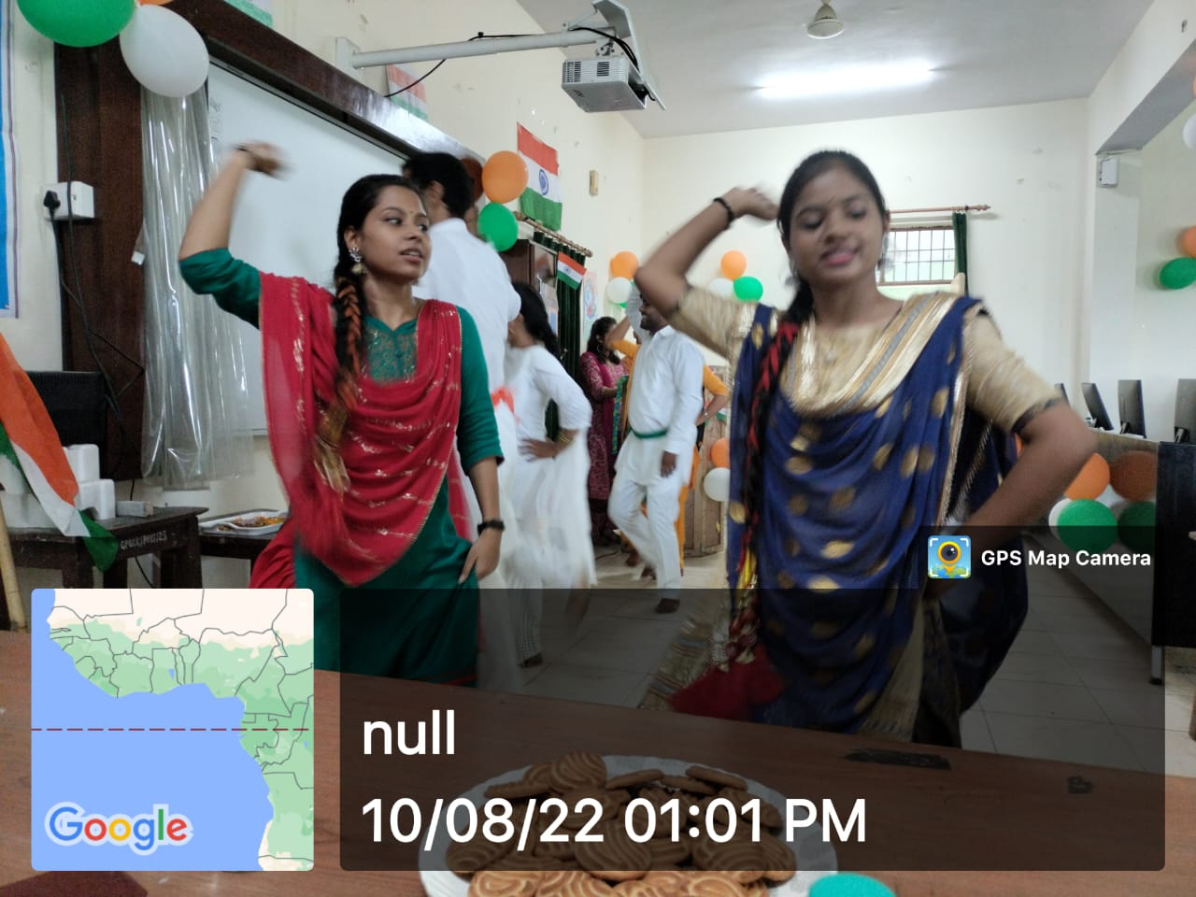
15th August, 2021
Ajadi Ka Amrit Mahotsav on August 15, 2021 following the title of Ajadi Ka Amrit Mahotsav where India was celebrating its cultural and historical progress.

Slide 5
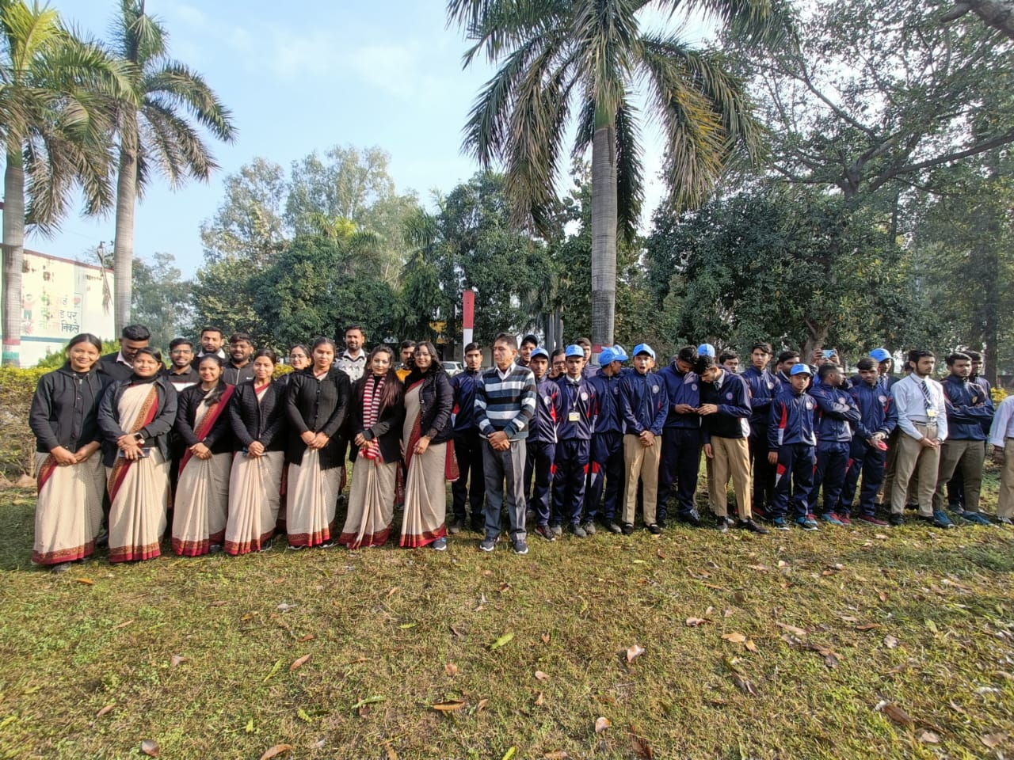
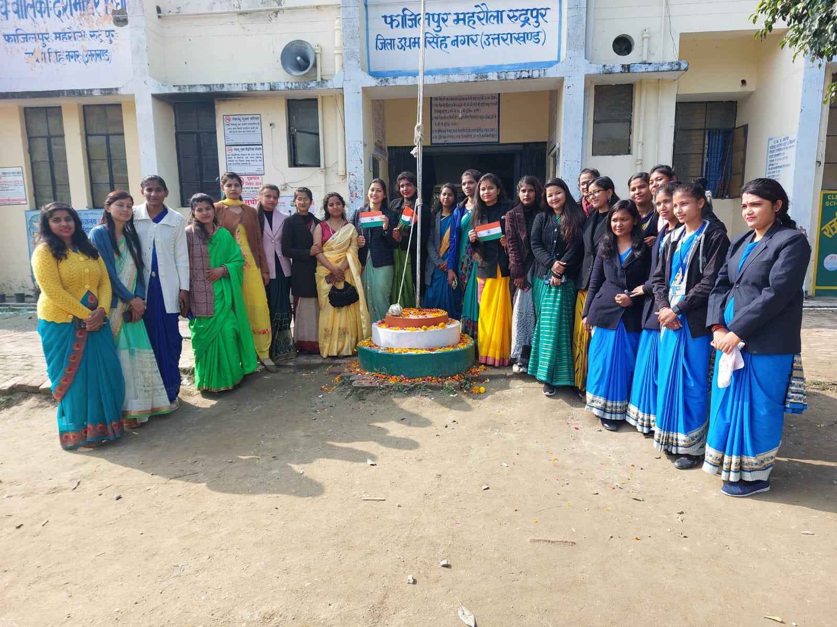
26th January, 2022
Republic Day
On January 26, 2022 Republic Day was celebrated in the department in which all the students participated in many activities like patriotic songs, poems and speeches.

Slide 6
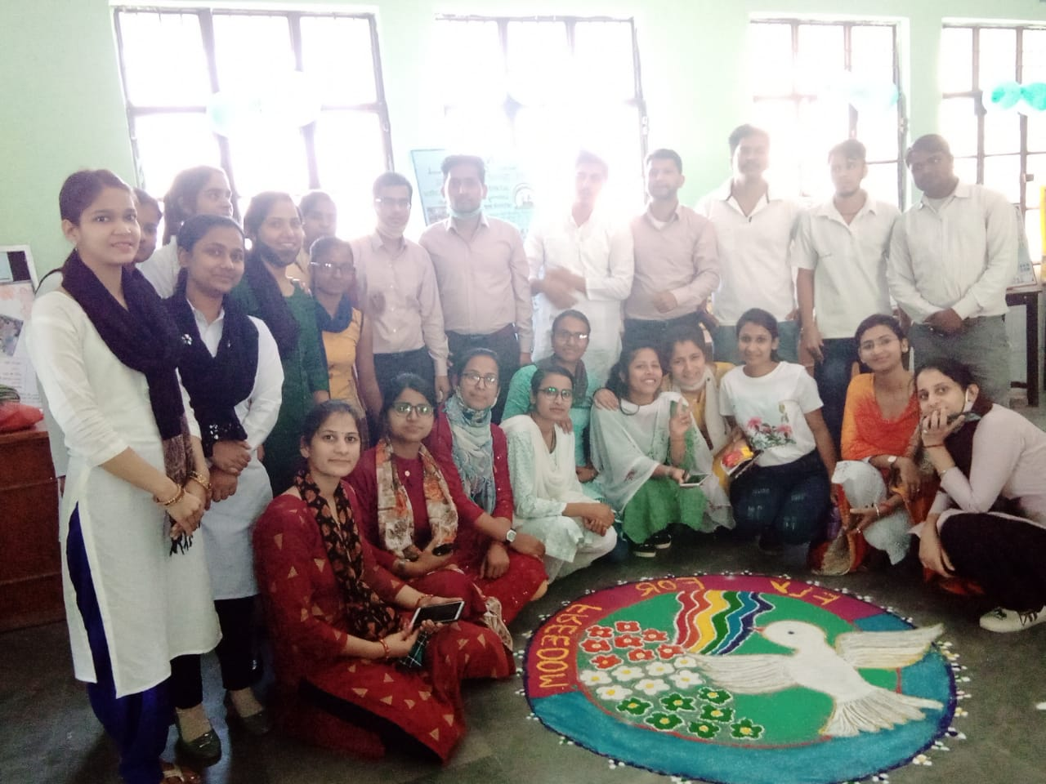
8March, 2022 International women's Day
On March8,2022International Women's Day was celebrated under the leadership of head of the department highlighting the constitutional rights of women for education justice, employment and social empowerment in our India.

Slide 7

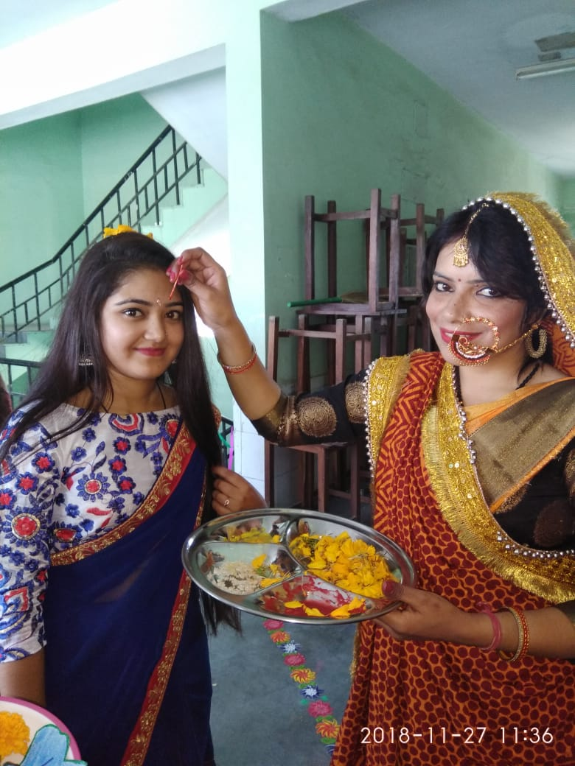
7th May 2022 Mothers day
On May7,2022, Mothers Day was celebrated with induction meeting of students in a proper way following the role and importance of mothers in our life simultaneously in induction meeting all the students introduced themselves very briefly.

Slide 8
28 May 2022 Menstrual day
On May28, 2022, Menstrual Day Hygiene program was held in the Presence of chief medical officer U.S. Nagar in which DM’s wife and MLA’s wife, head of the department and other faculty members including girls students participated in this program very warmly where the chief medical officer made all the girls aware about the menstrual hygiene and its effect in society. It was very informative not only for the students but whoever participated in this program.

Slide 9
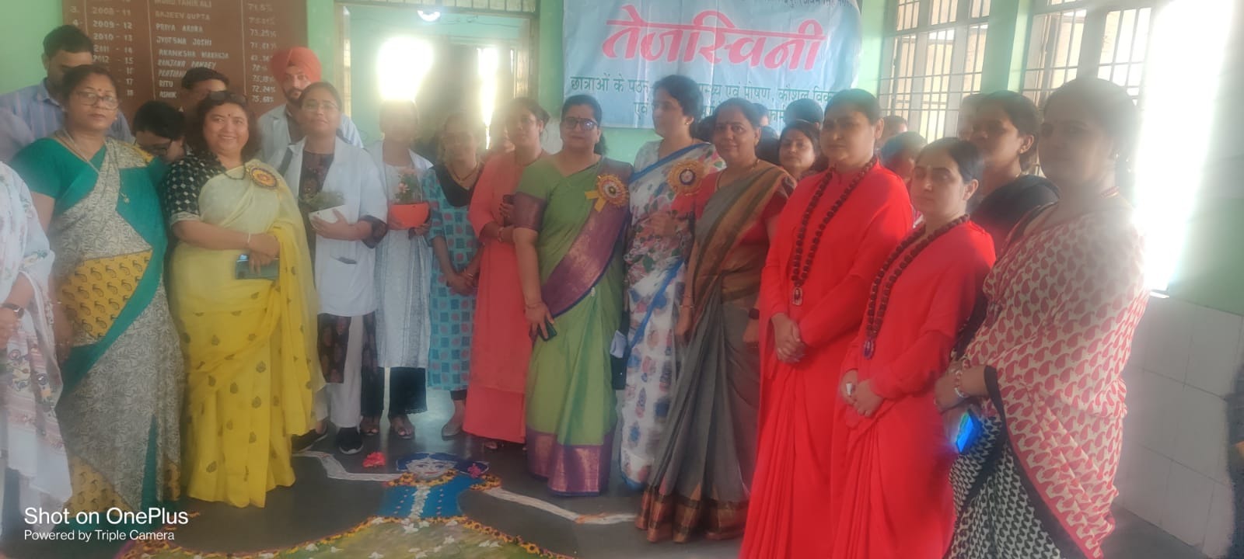
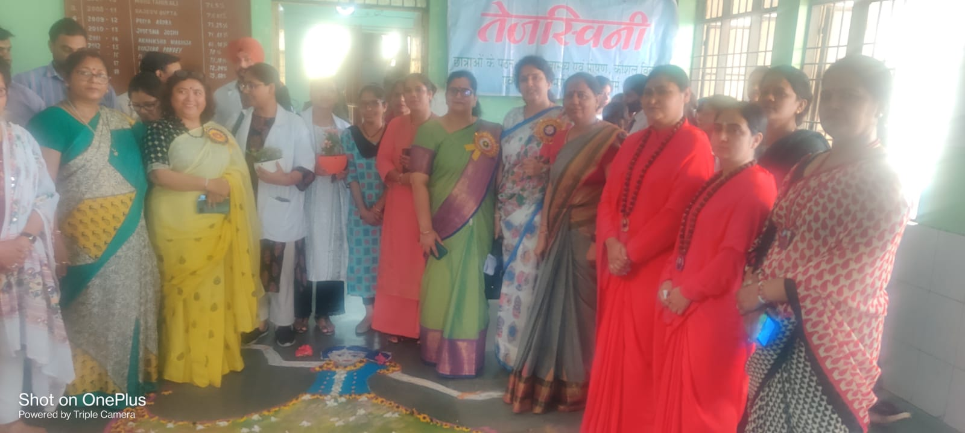
28 May 2022 Menstrual Day

Slide 10
May 31,2022
Tobbbaco Nishedh Divash
On May 31, 2022, Tobbbaco Nishedh Divash was also celebrated by the department where the entire student including head and faculty members of the department participated very respectively. In this program of awareness where the major draw backs of Tobacco on human beings highlighted very minutely. We should always be far-far away from such harmful things because it is a major cause of many critical diseases like Cancer, Asthma etc. In this way such type of awareness program are always held in department regularly.

Slide 11
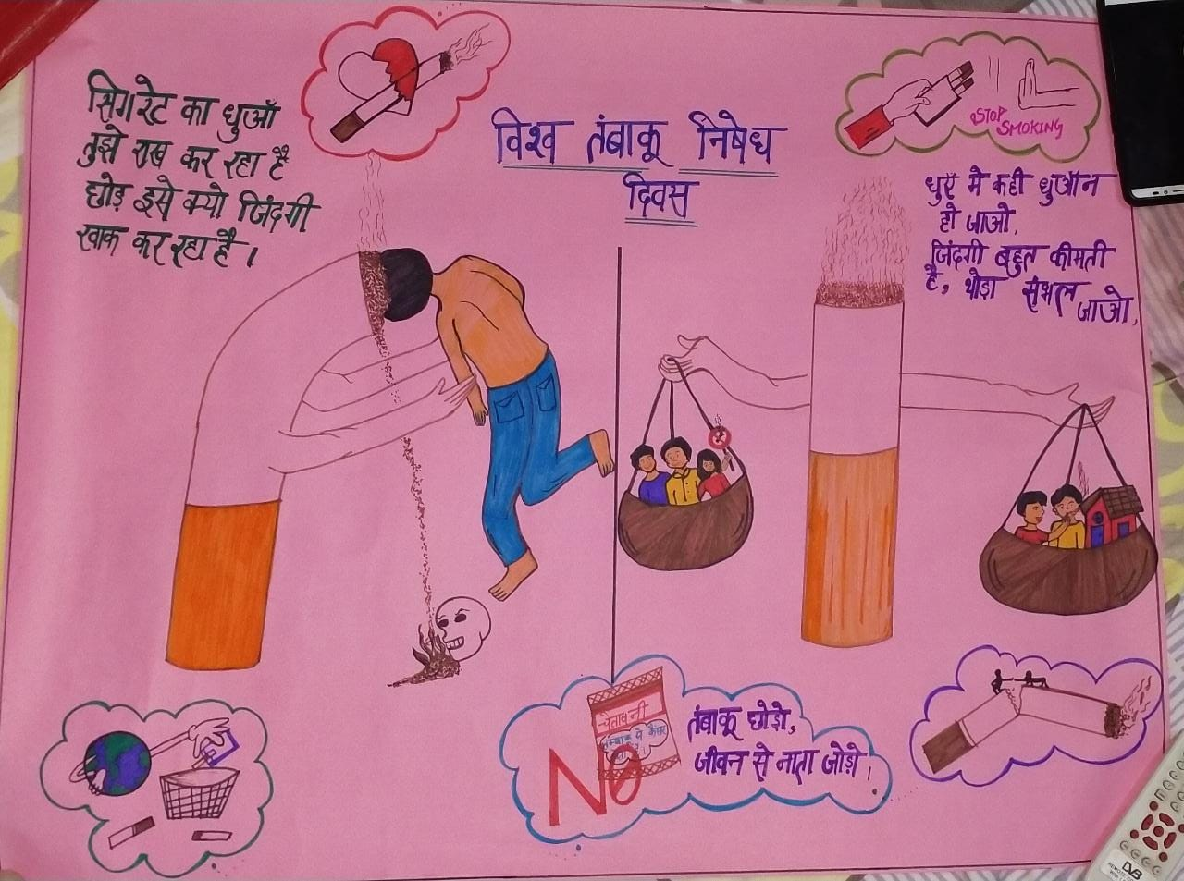
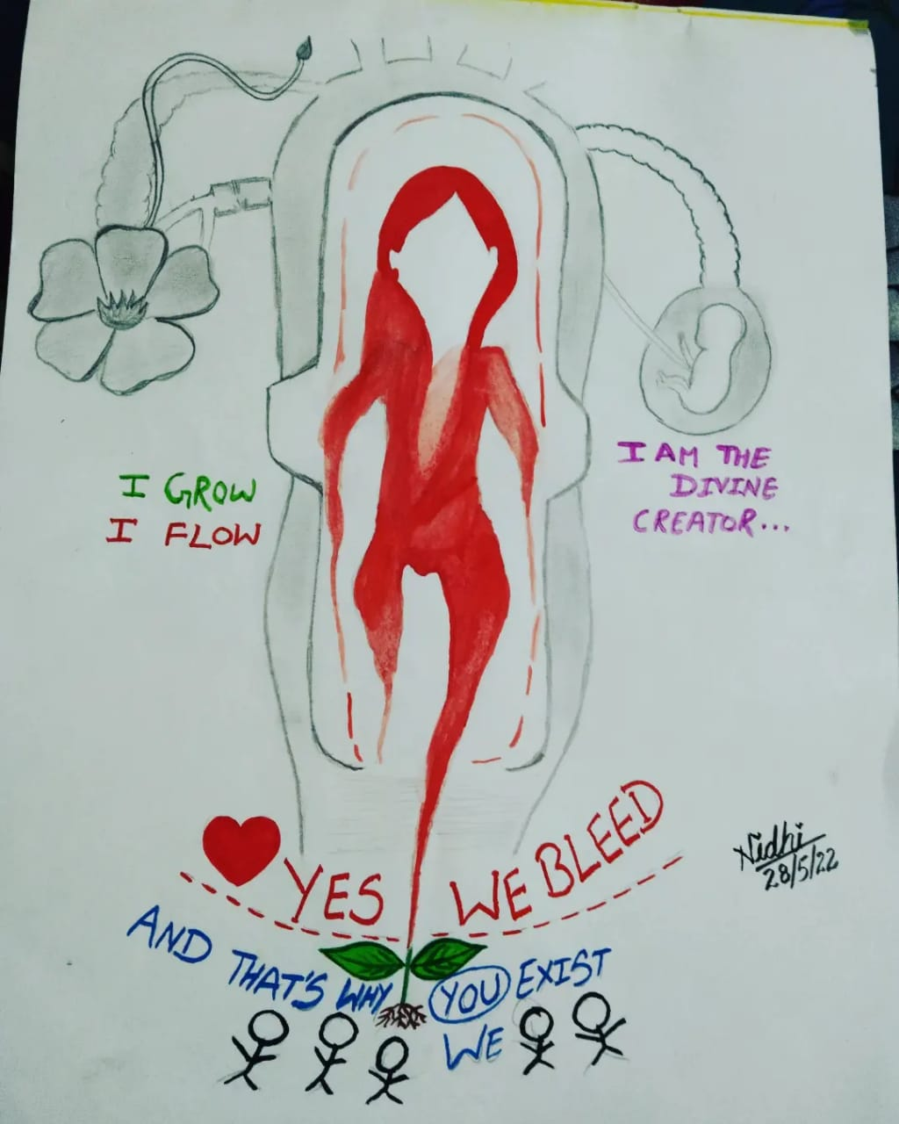
May 31,2022
Tobbbaco Nishedh Divash

Slide 12
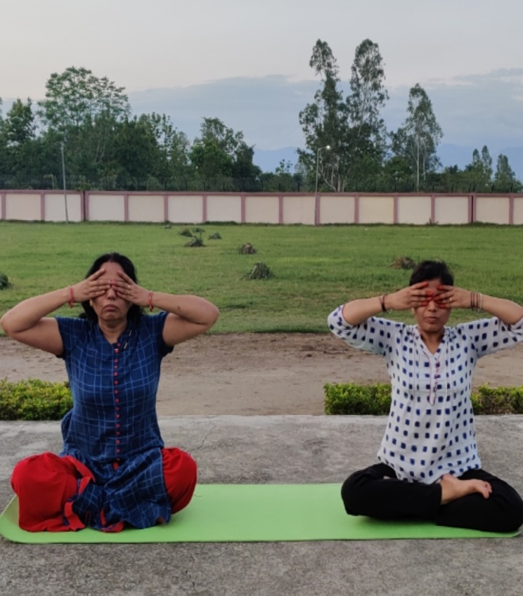
June 21, 2022, An International Day of Yoga
On June 21, 2022, An International Day of Yoga was celebrated highlighting the role and importance of it in the contemporary time of anxiety, frustration, depression & suppression. In the sequence of innovative initiatives; Azadi ka Amrit Mahotsaw program following Har Ghar Tiranga Abhiyan was organised .

Slide 13
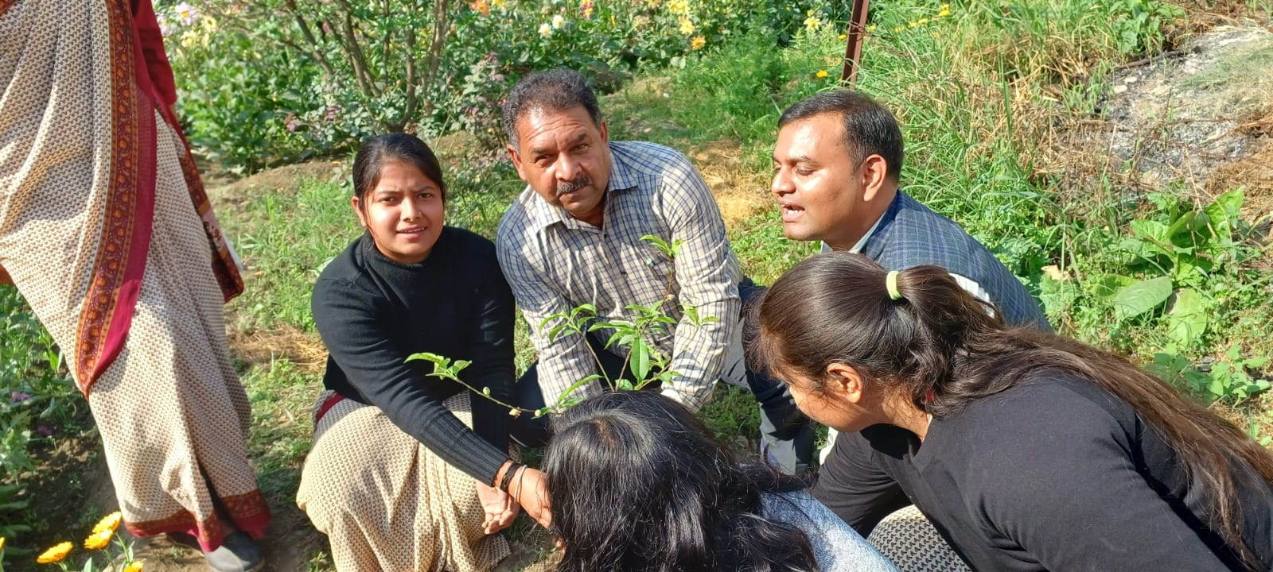
5th June World Environment Day
World Environment Day was held on June 5, 2022 in the august presence of Director, Board of Directors, Horticulture, Ministry of Agriculture & Farmer Welfare, Govt. of India, New Delhi, in which different fruit-plants were planted by the students following the title of Green Campus & Clean Campus.

Slide 14
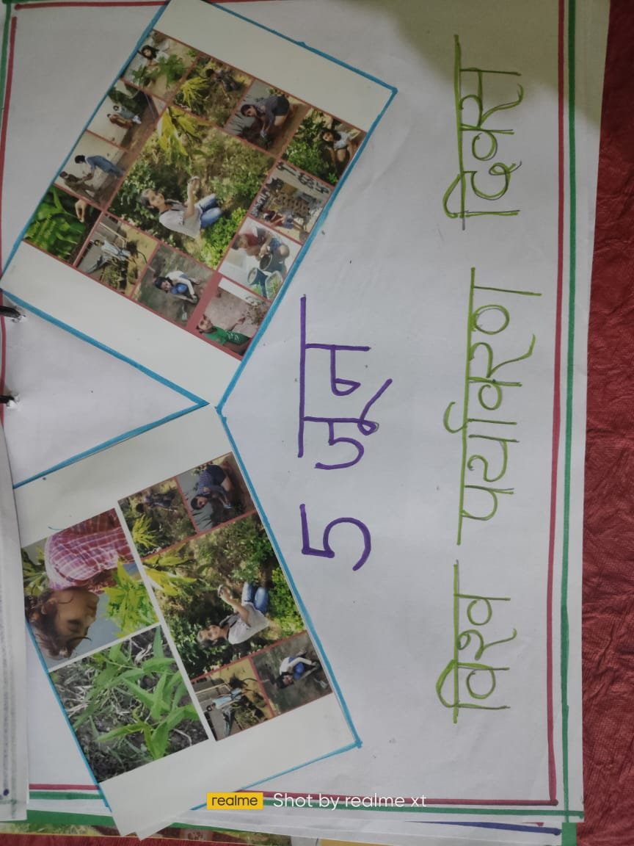
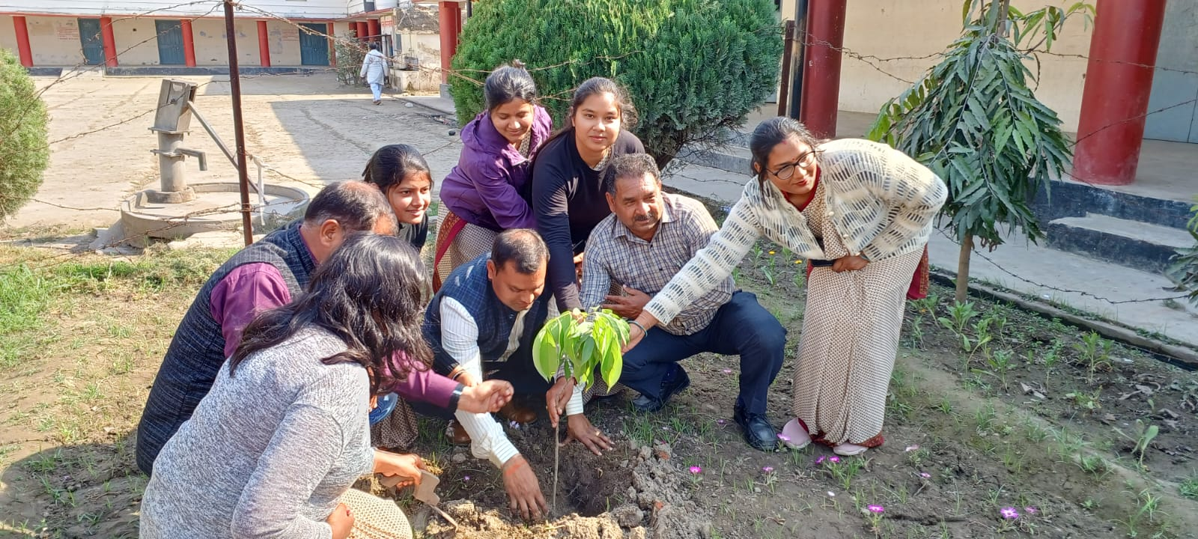
5th June World Environment Day

Slide 15
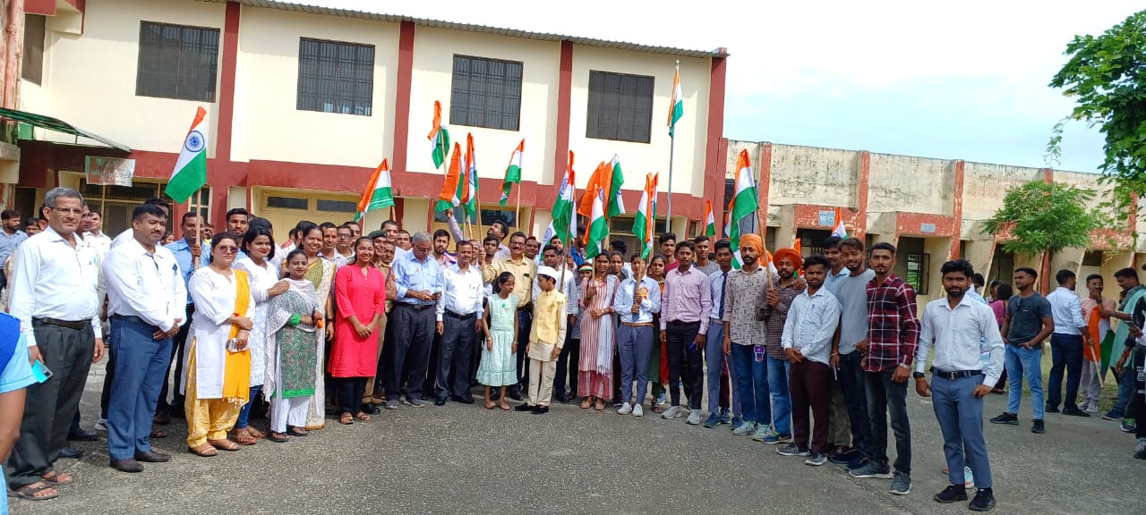
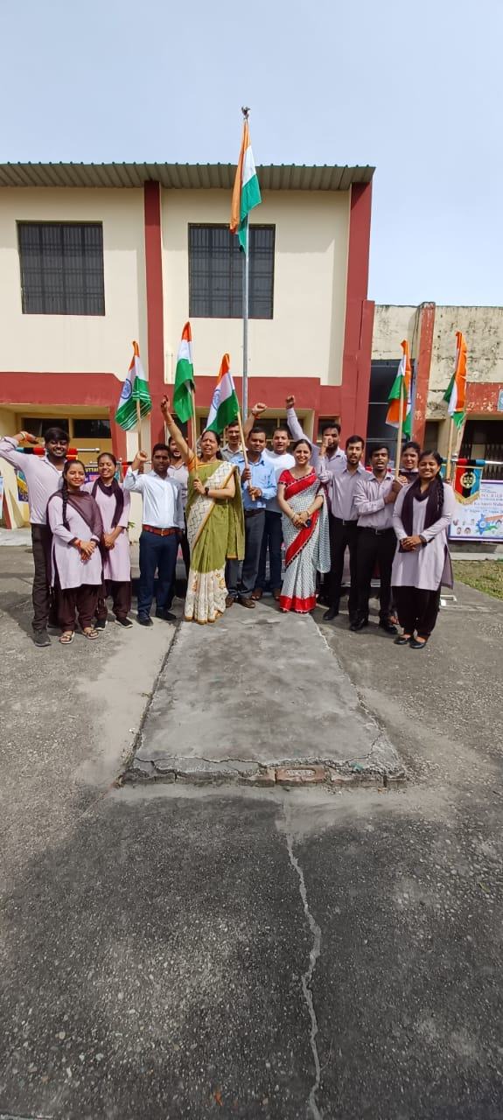
On August 15, 2022Independence Day
On August 15, 2022, Independence Day was also celebrated in the department where all the students participated in cultural programs and patriotic songs.

Slide 16
August 31, 2022, a group of students visited at Panchayti Raj Institution, Rudrapur
On August 31, 2022, a group of students visited at Panchayti Raj Institution, Rudrapur where state level training of Panchayati Raj workers is conducted throughout the year. All the students observed the Panchayati Raj system very closely with proper interaction with the head of the Institution.

Slide 17
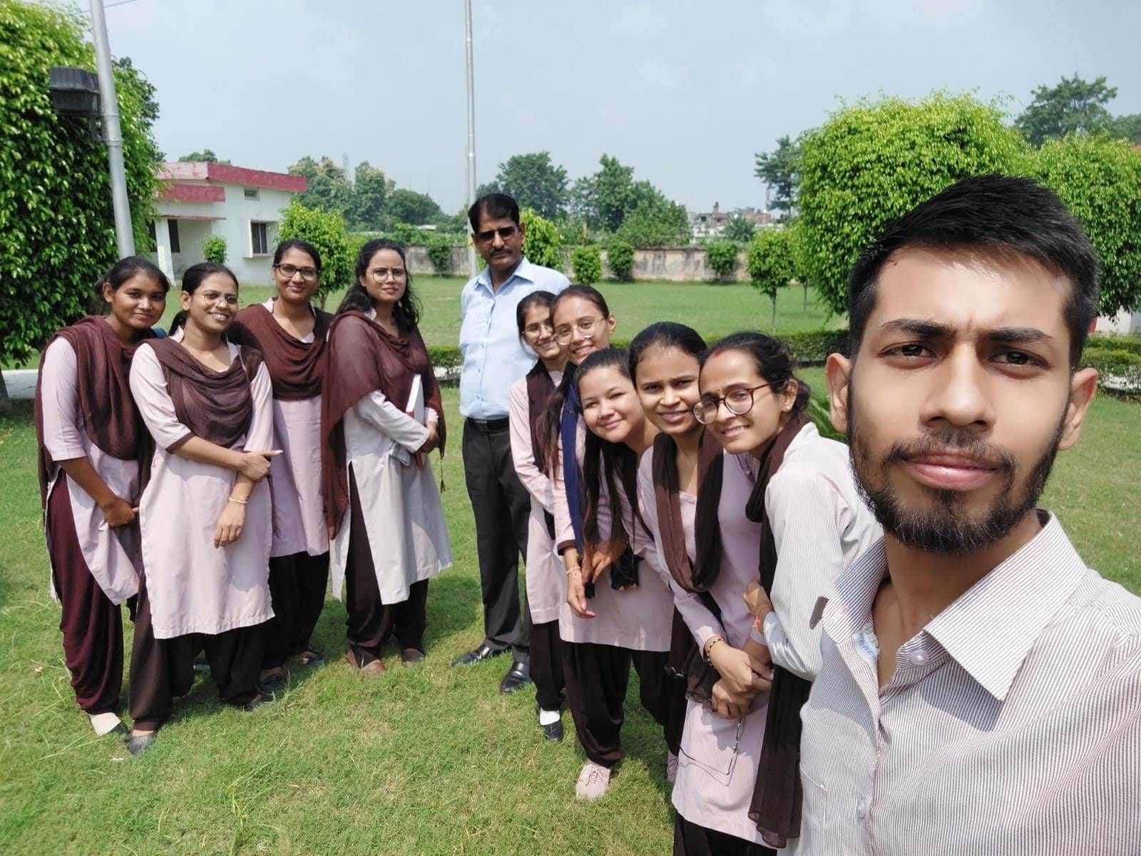
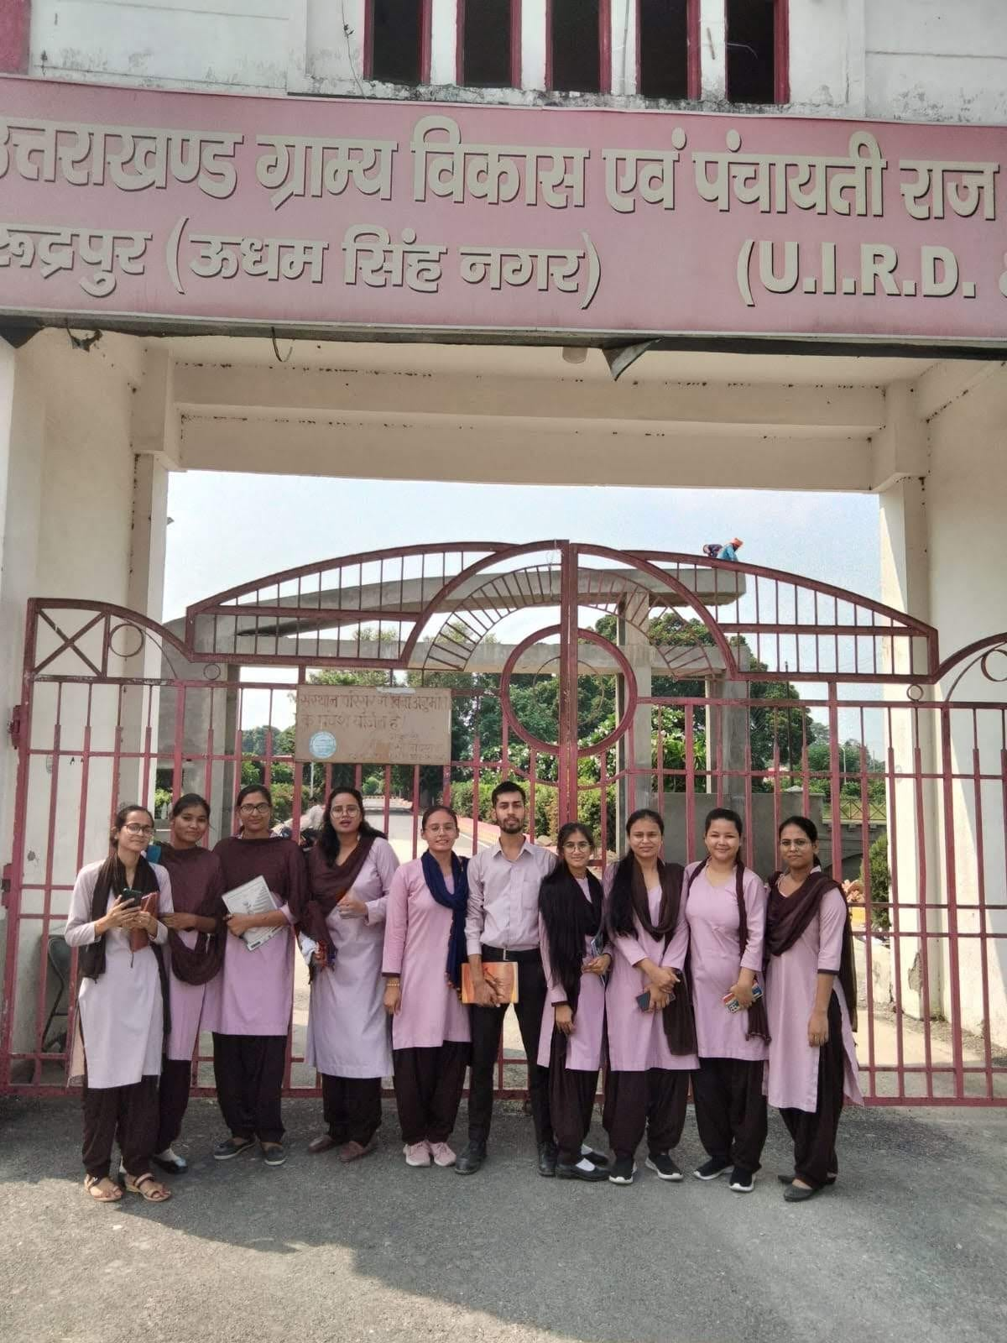
August 31, 2022, a group of students visited at Panchayti Raj Institution, Rudrapur

Slide 18
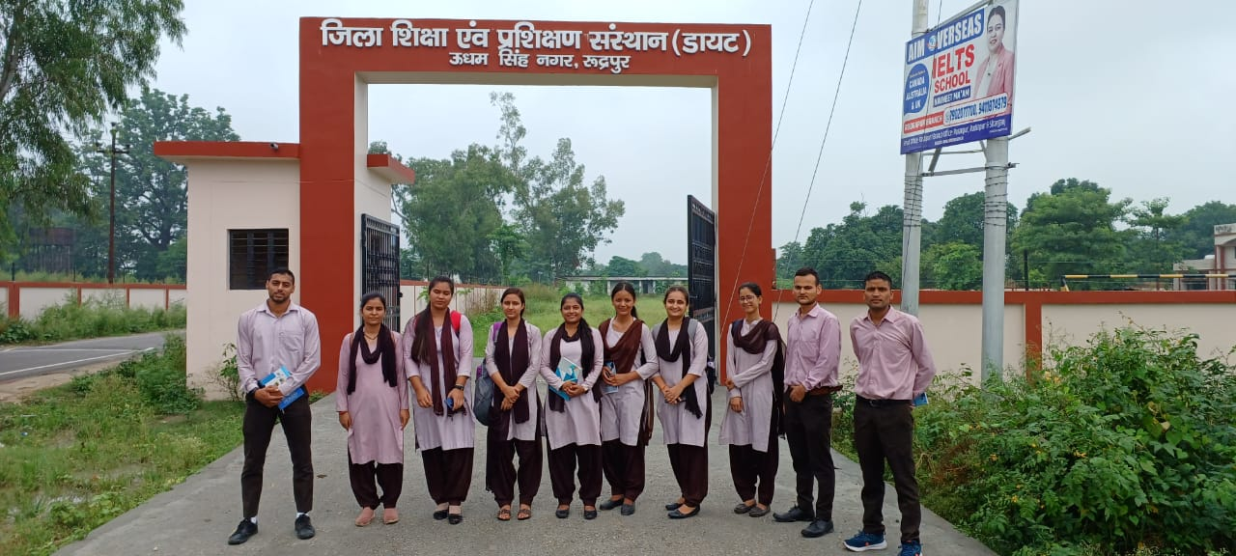
Sept. 01, 2022, a group of student visited at DIET, Rudrapur, U.S. Nagar
On Sept.01, 2022, a group activity in which the students visited at DIET, Rudrapur, U.S. Nagar . During the visit students tried to know all about DIET structure including the vision, mission, objective, instructional learning & training system etc.

Slide 19
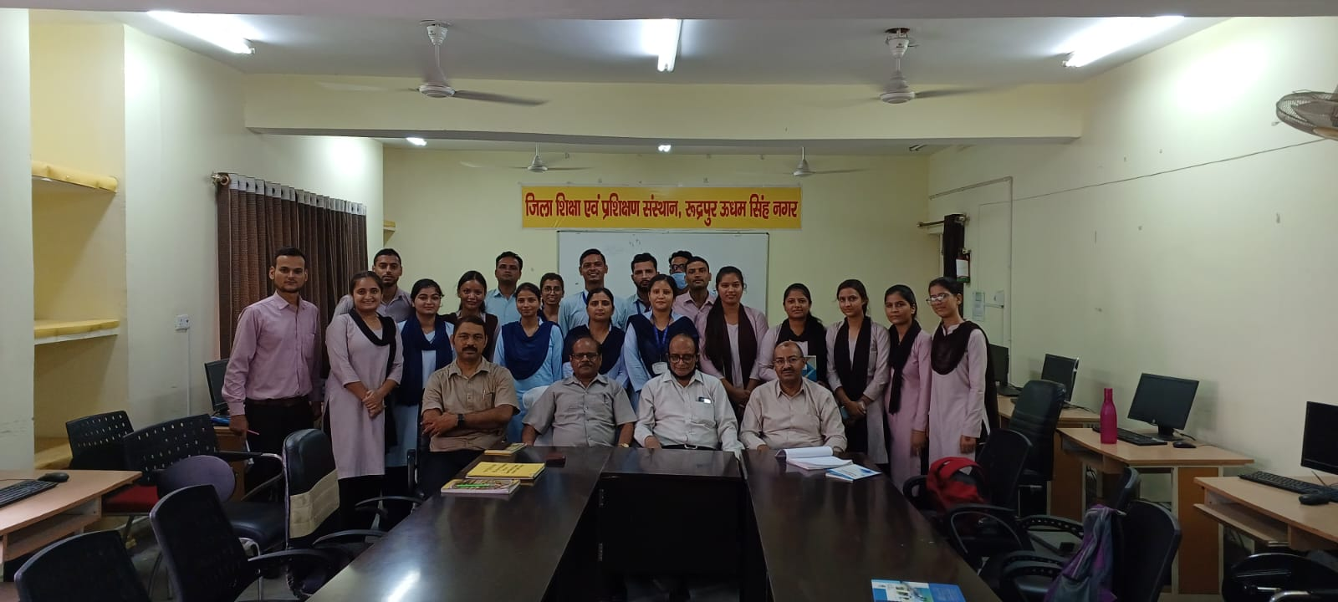
Sept. 01, 2022, a group of student visited at DIET, Rudrapur, U.S. Nagar

Slide 20
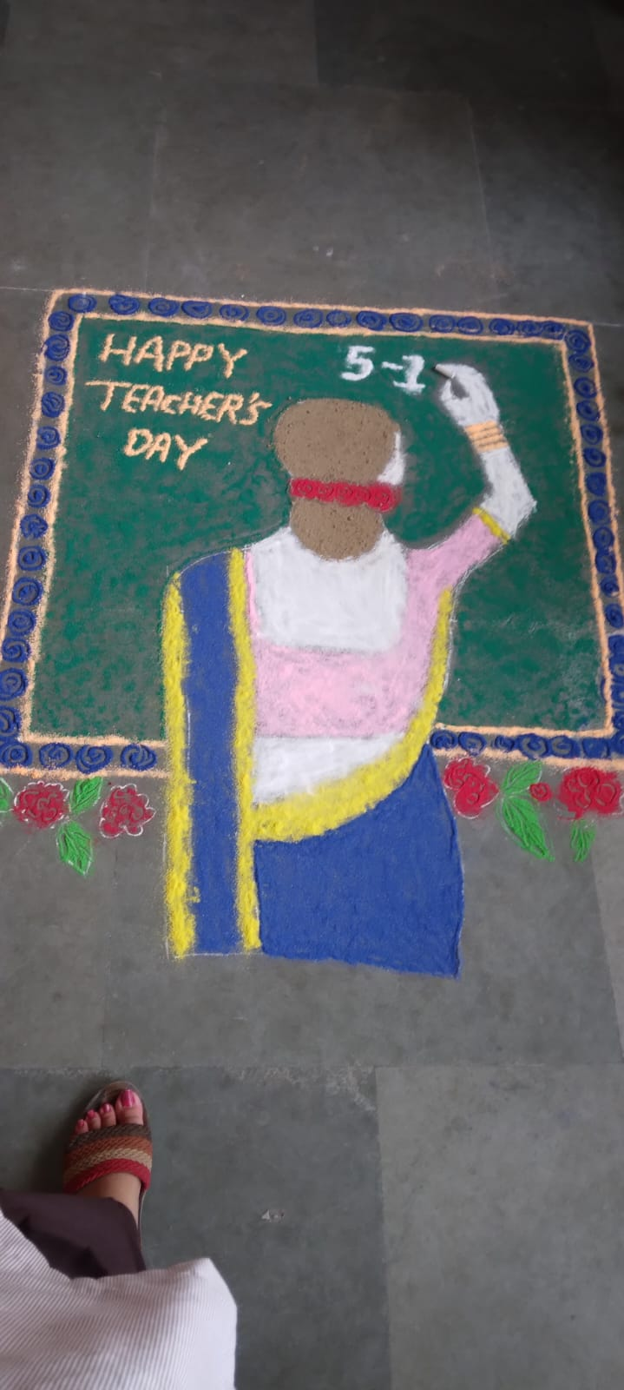
Sept.05, 2022, a program of Teachers Day
On Sept.05, 2022, a program on Teachers Day was celebrated very warmly by the trainee teachers following the title of teacher as a friend, philosopher & guide
.

Slide 21
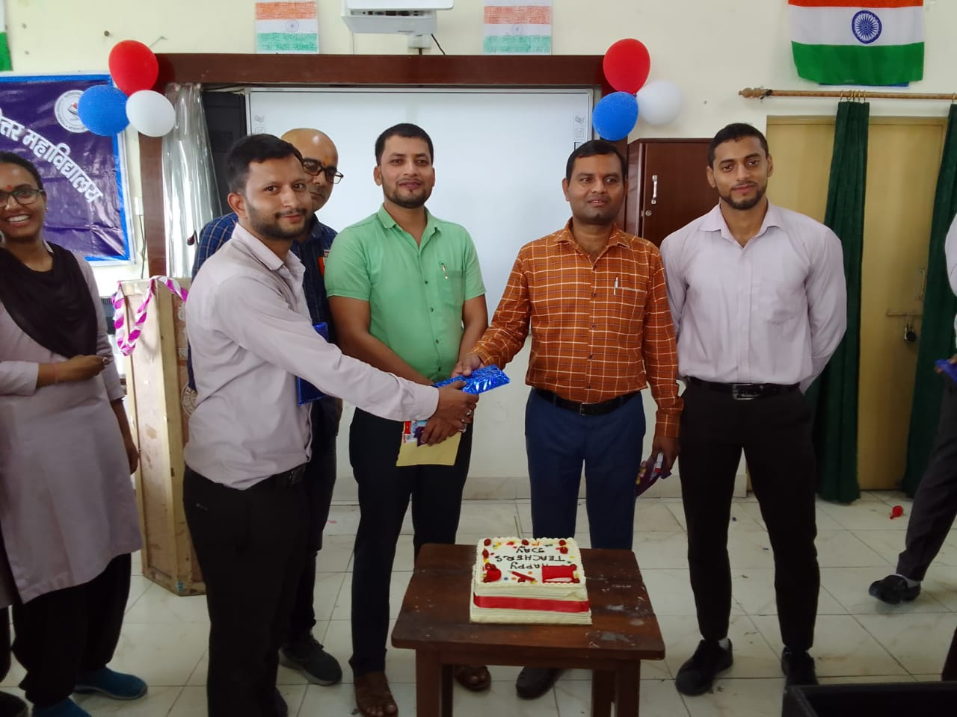
Sept.05, 2022, a program of Teachers Day

Slide 22
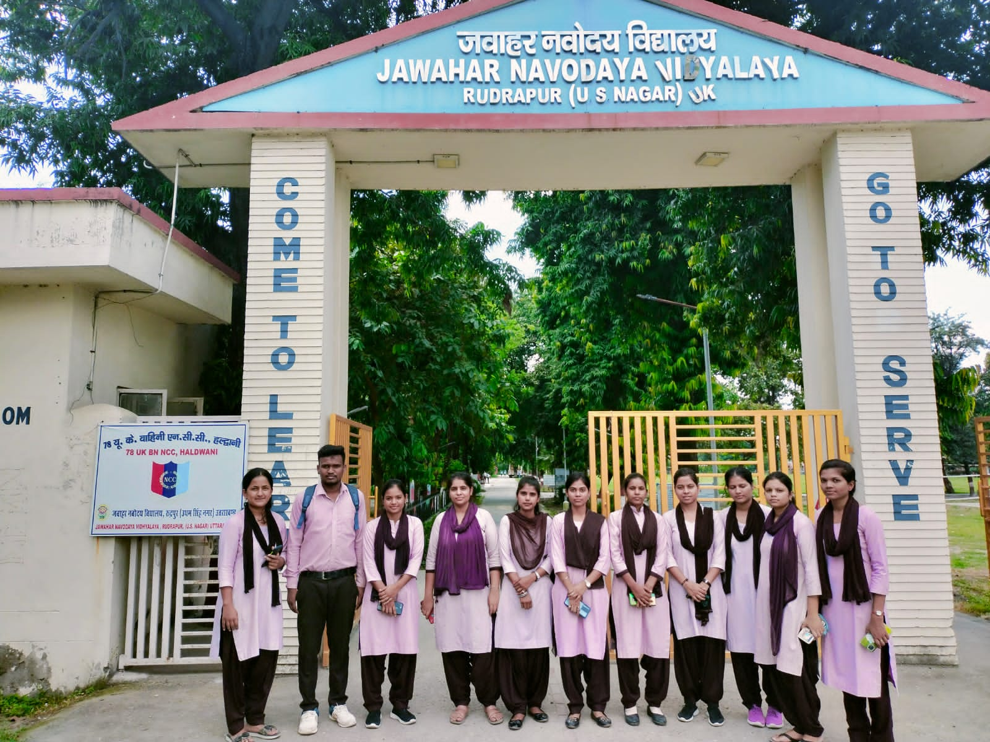
Sept.12,2022., a group of students were visited Jawahar Nawoday Vidhyalay, Rudrapur,
U.S. Nagar
On Sept.12,2022, a group of students visited Jawahar Nawoday Vidhyalay, Rudrapur, U.S. Nagar where the students tried to know the overall system of teaching & learning following the day- to-day activities of residential institute of Sen. Secondary education which is considered the backbone of throughout the educational career of students.

Slide 23
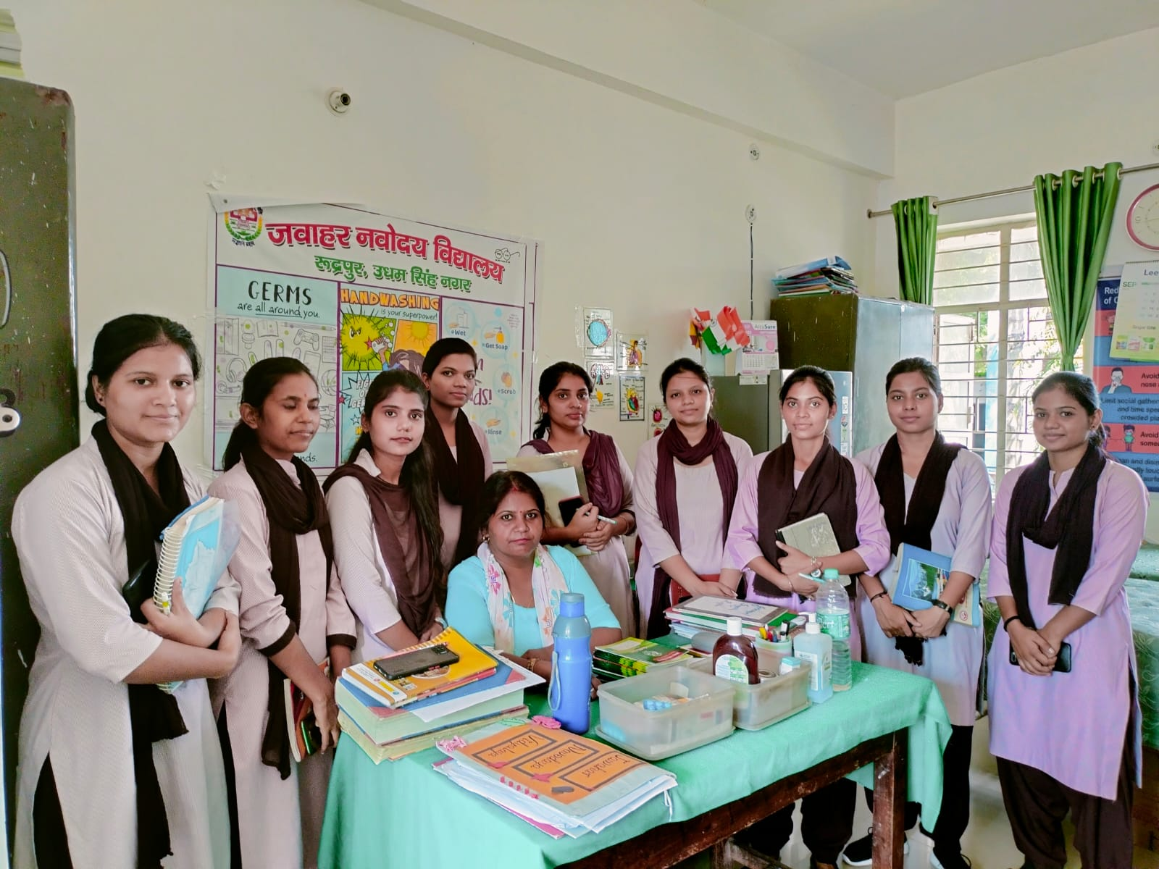
Sept.12,2022., a group of students were visited Jawahar Nawoday Vidhyalay, Rudrapur,
U.S. Nagar
.

Slide 24
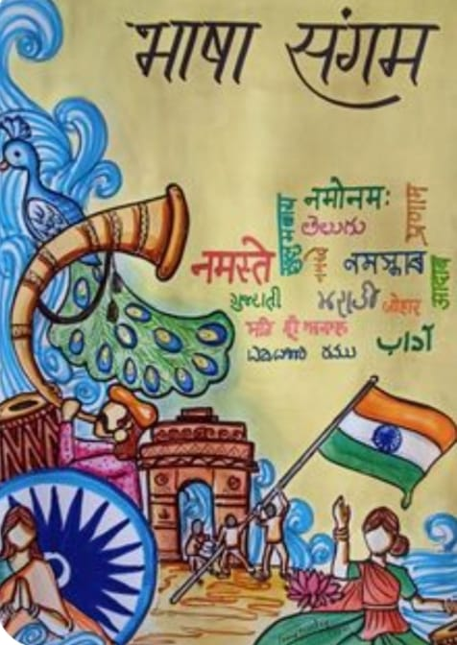
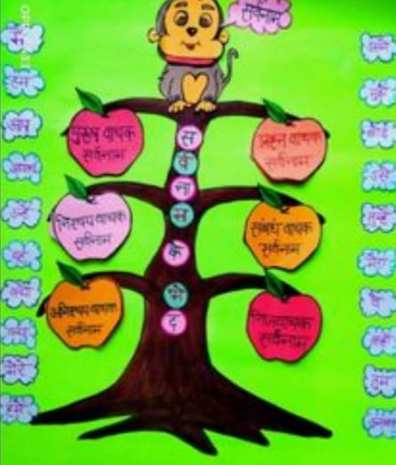
14sep Hindi Diwas 2022 Poster competition
On Sep 14, 2022 B.Ed. Department Organised a group activity on the occasion on Hindi Diwas many activity like chart Poster computation on group presentation on Hindi vyakarana was presented by the students very enthusiastically the aim of celebrating Hindi Diwas is to promote Hindi bhasha and vyakarana.

Slide 25
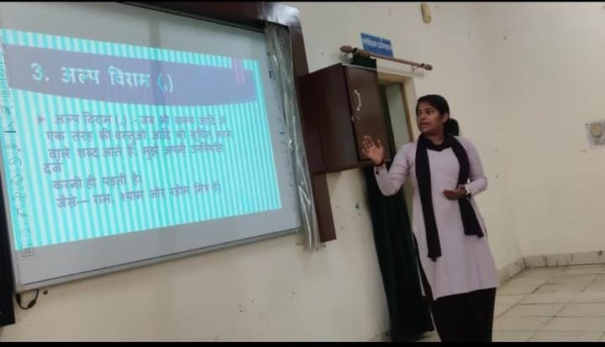
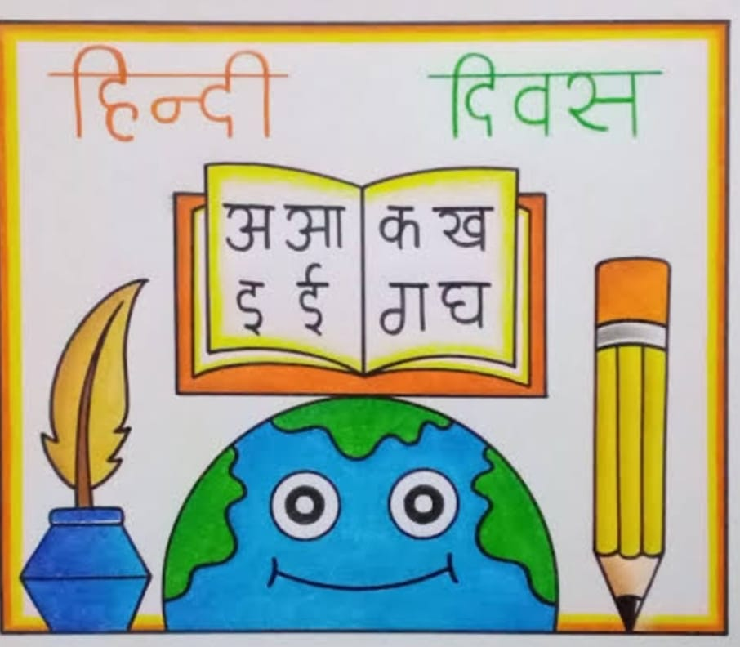
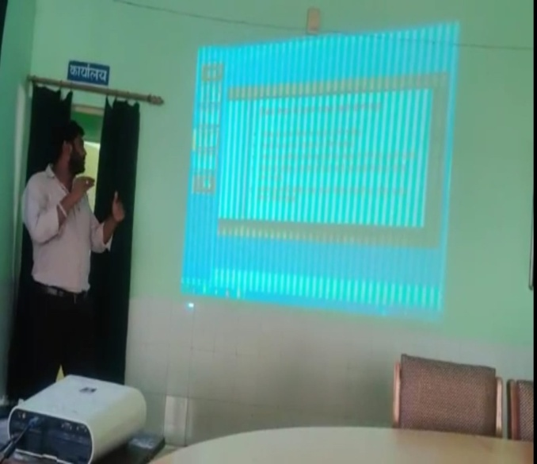
14sep Hindi Diwas 2022 Poster competition

Slide 26
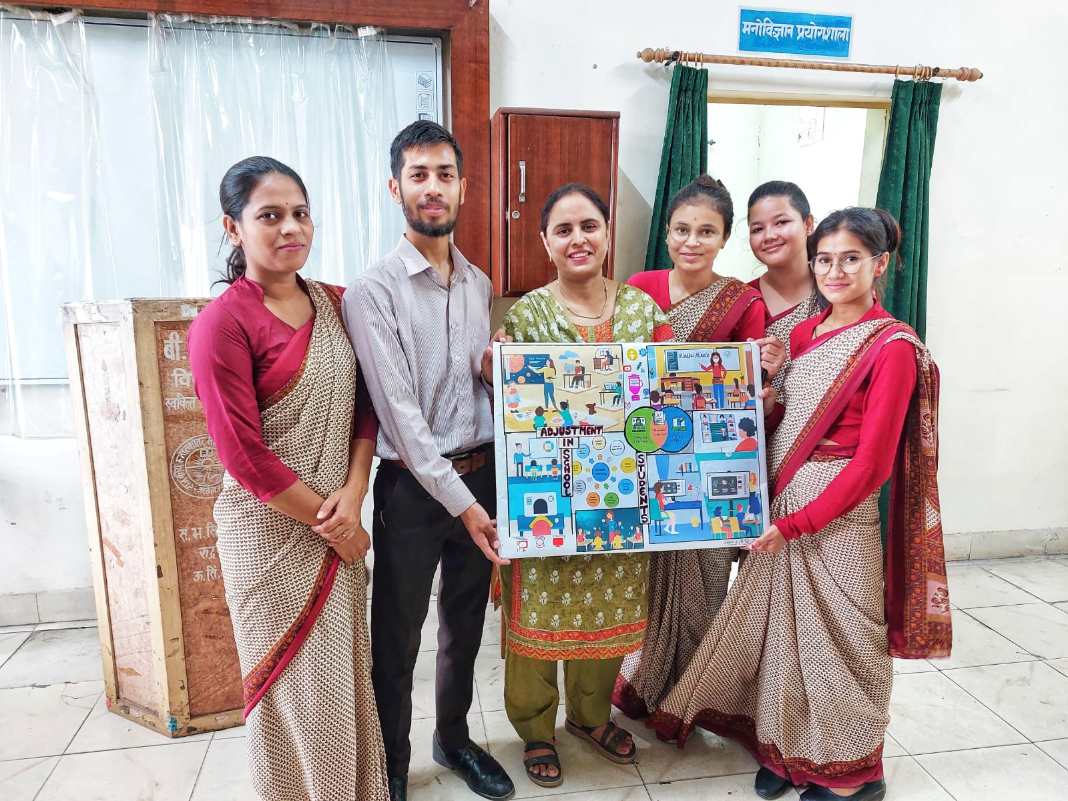
Sept. 23, 2022, a Chart Making Competition
On Sept. 23, 2022, a Chart Making Competition organized under the subject of Psychology where all the students participated very enthusiastically in making different type of creative and innovative charts.

Slide 27
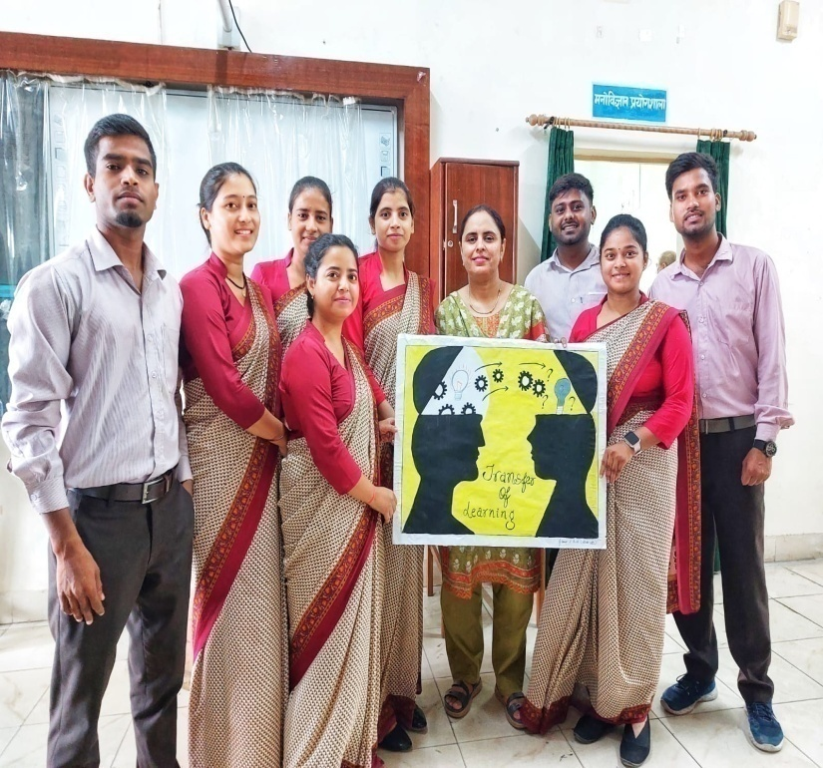
Sept. 23, 2022, a Chart Making Competition

Slide 28
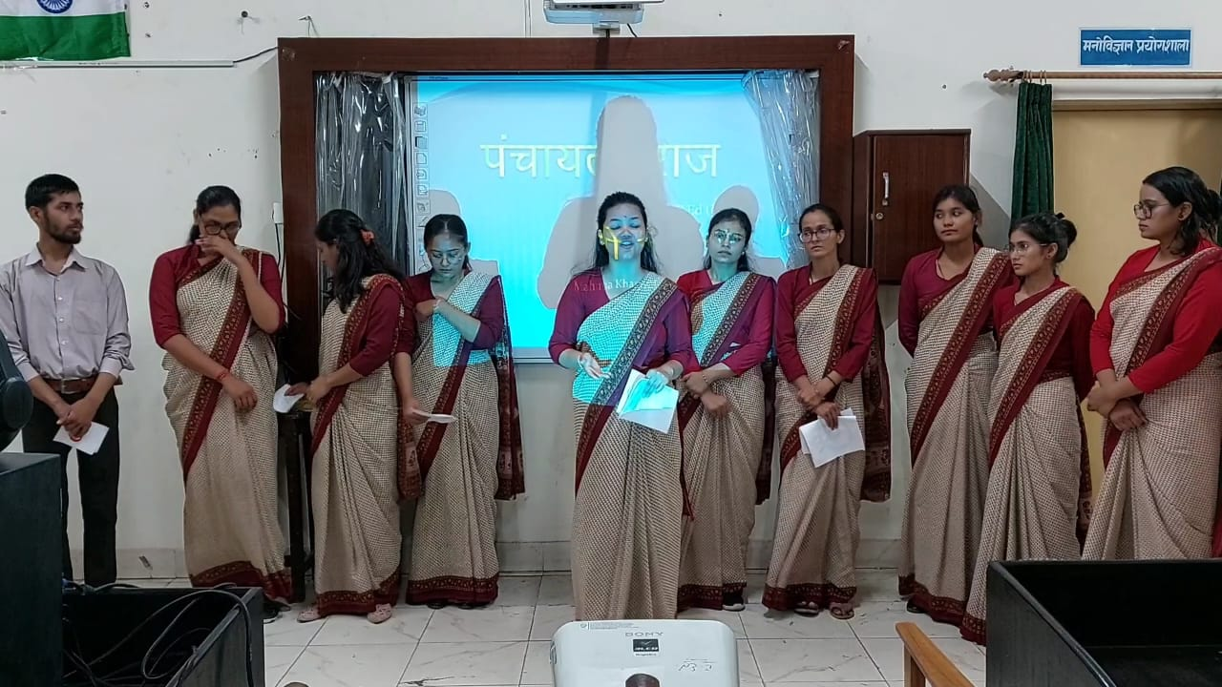
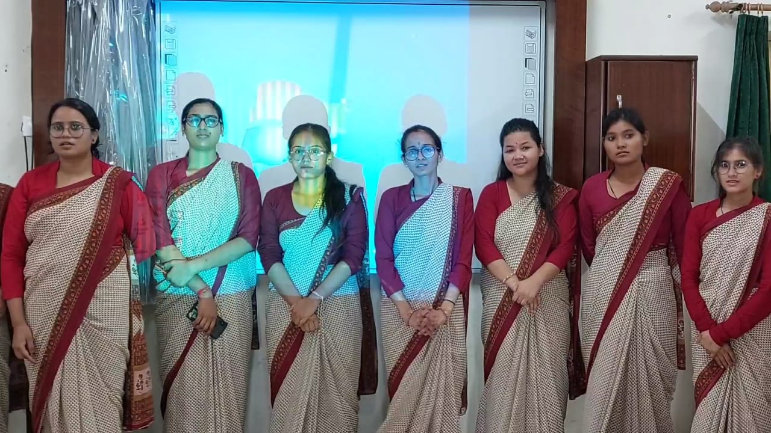
On Sept 26, 2022 visit presentation on visit to PRI done by students in proper way.
On Sept 26, 2022, students-visit-presentation of PRI organized in the department in a proper way by the student.

Slide 29
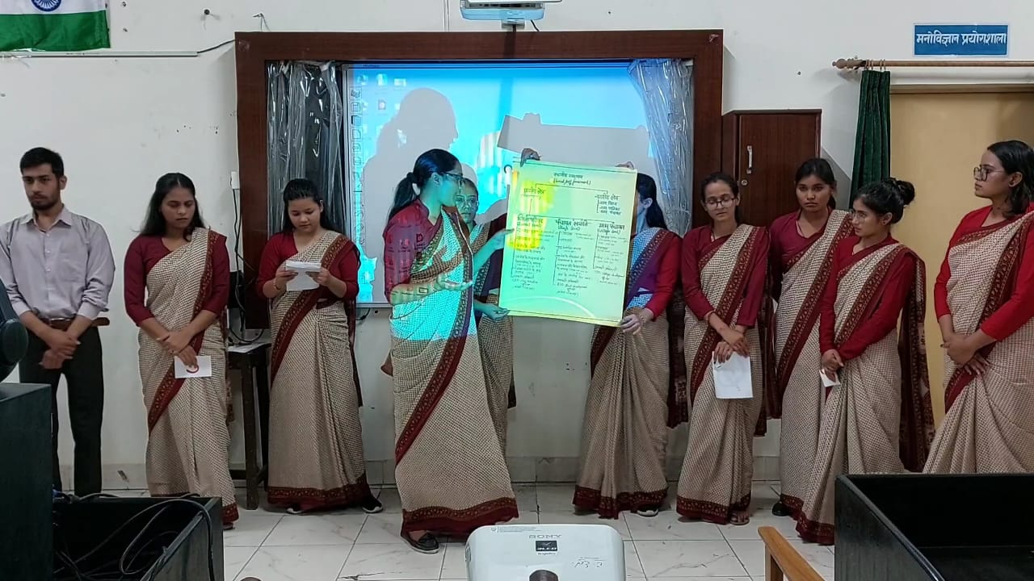
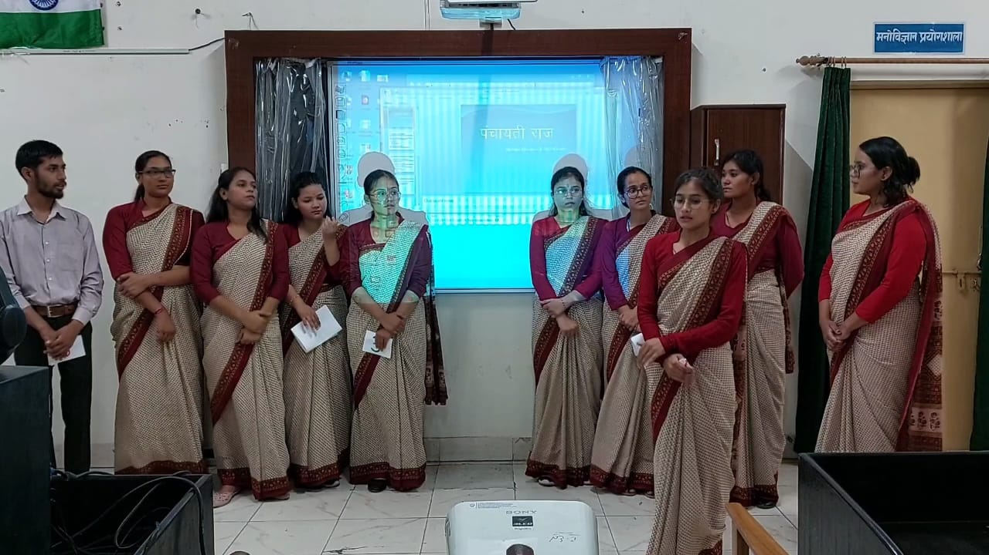
On Sept 26, 2022 visit presentation on visit to PRI done by students in proper way.

Slide 30
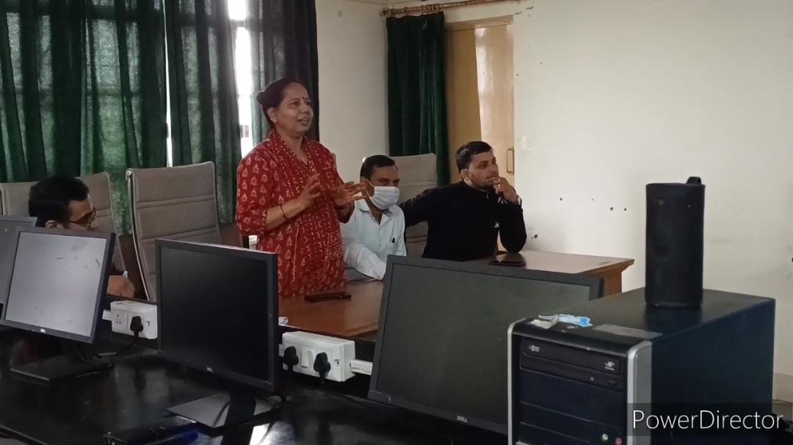
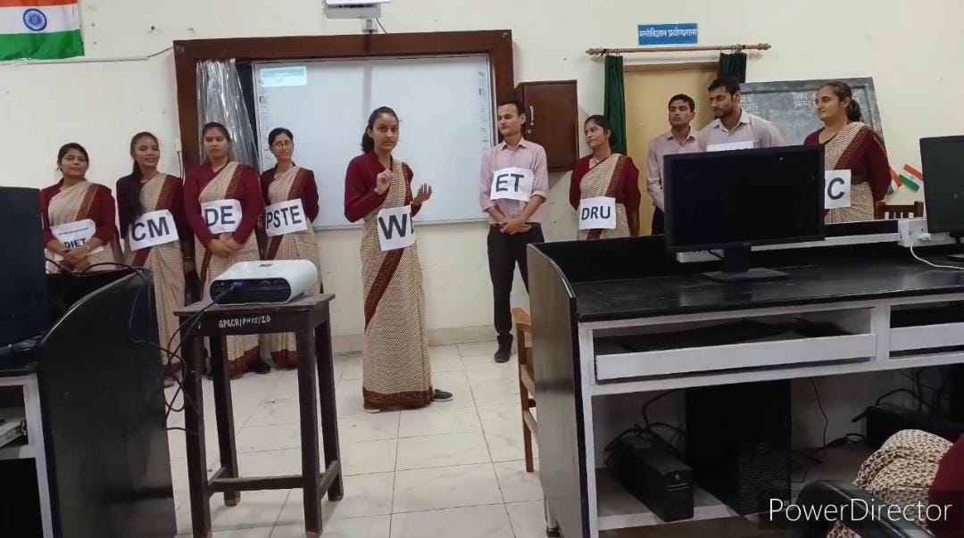
October10, 2022, DIET visit presentation program was held in the department by the student under the supervision of faculty members.
On October10, 2022, DIET visit presentation program was held in the department by the student under the supervision of faculty members.

Slide 31
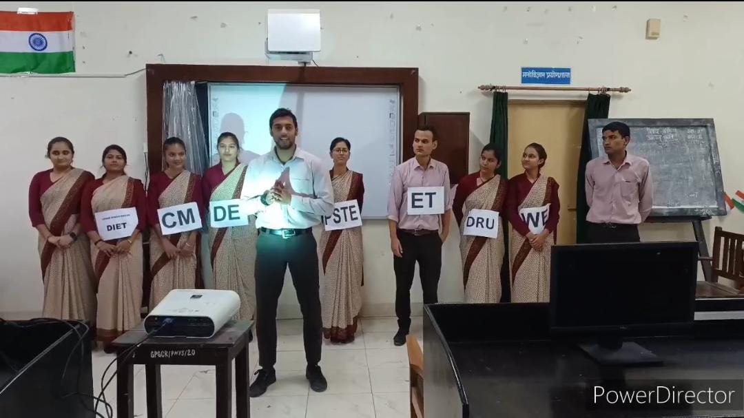
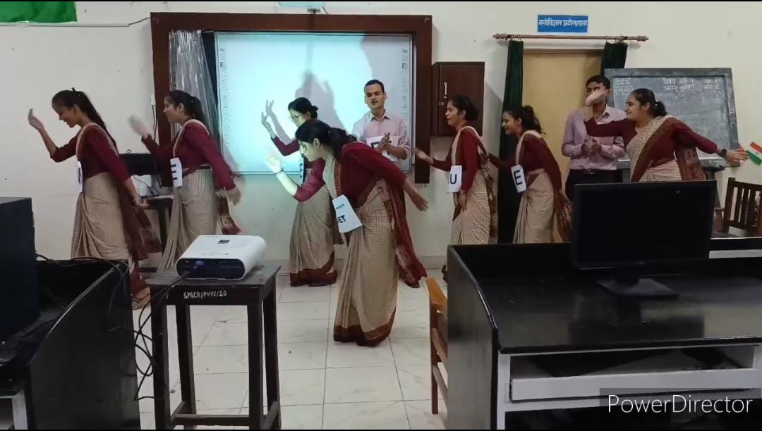
October10, 2022, DIET visit presentation program was held in the department by the student under the supervision of faculty members.

Slide 32
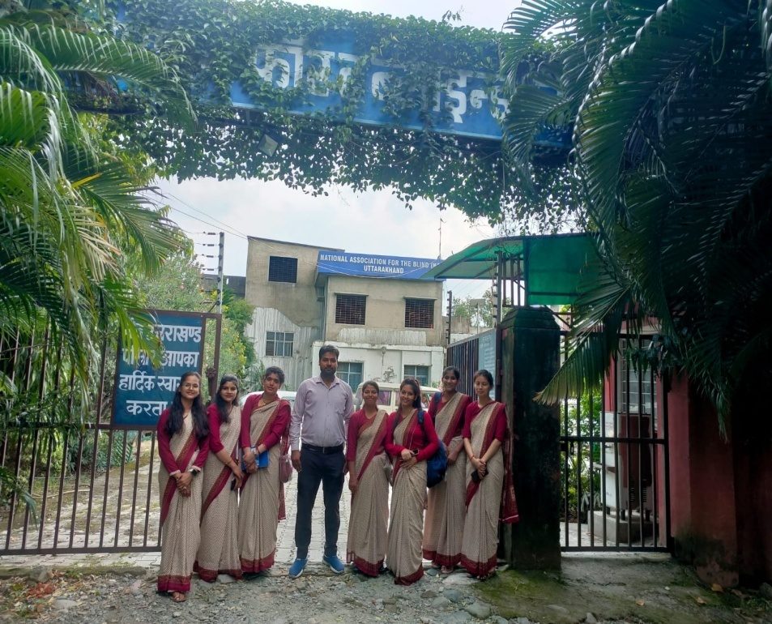
Oct.01, 2022., A group of students visited at National Association for Blind, Haldwani, Nainital
On Oct.01, 2022, a group of students visited at National Association for Blind, Haldwani, Nainital where all the trainee teachers interacted with the Blind students including Principal and staff members for geting information related overall operating & managing systems of teaching, learning, adjustment and inclusive development under Rehabilitation Council of India’s rules and regulations following different constitutional rights and safeguard for such learners.

Slide 33
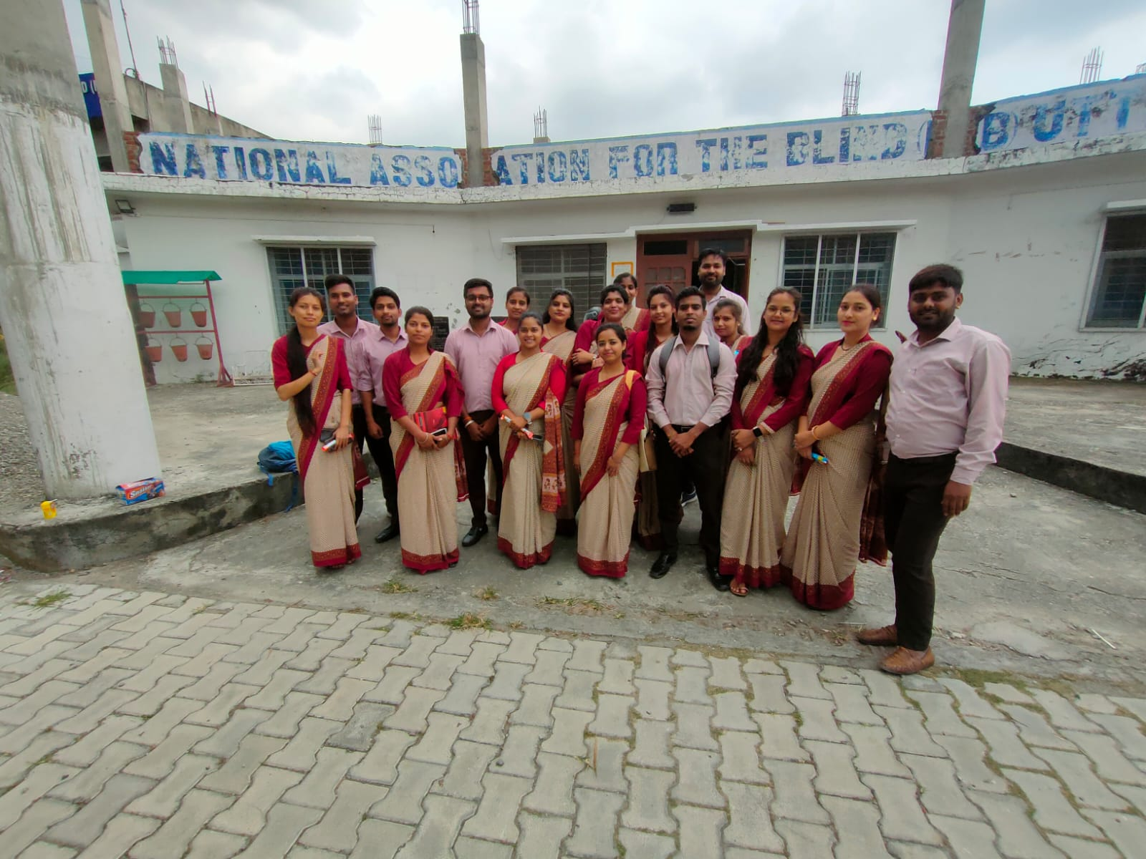
Oct.01, 2022., A group of students visited at National Association for Blind, Haldwani, Nainital

Slide 34
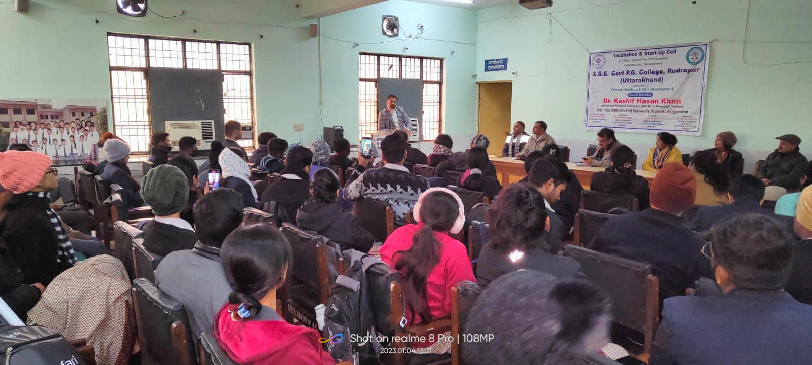
On January 4, 2023., An International Lecture on Finance, Banking & Skill Development .
On January 4, 2023, an International Lecture on Finance, Banking & Skill Development was sponsored by Parijat Educational & Welfare Society (NGO) in Collaboration of C-TRED and Department of Education where Dr. Kashif Hasan Khan, Asso. Prof. All- Too- International University, Bishkek, Kyrgyzstan, Central Asia, was invited as a chief guest & key note speaker for delivering his lecture in which all the students participated very enthusiastically.

Slide 35
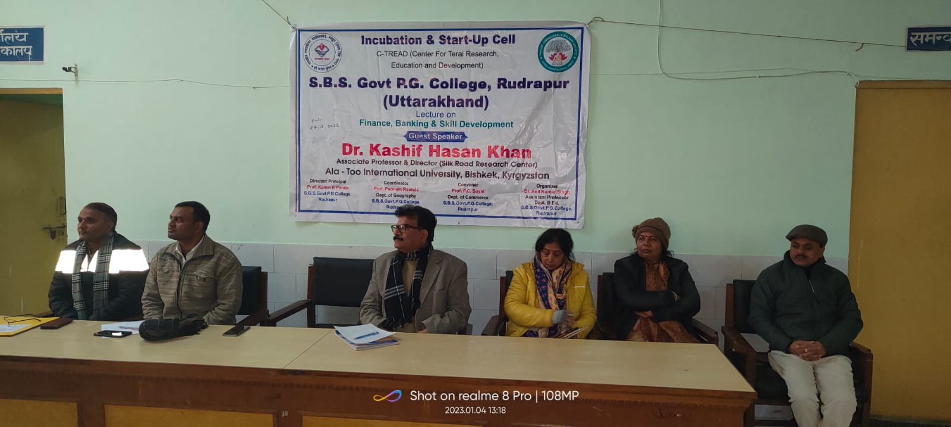
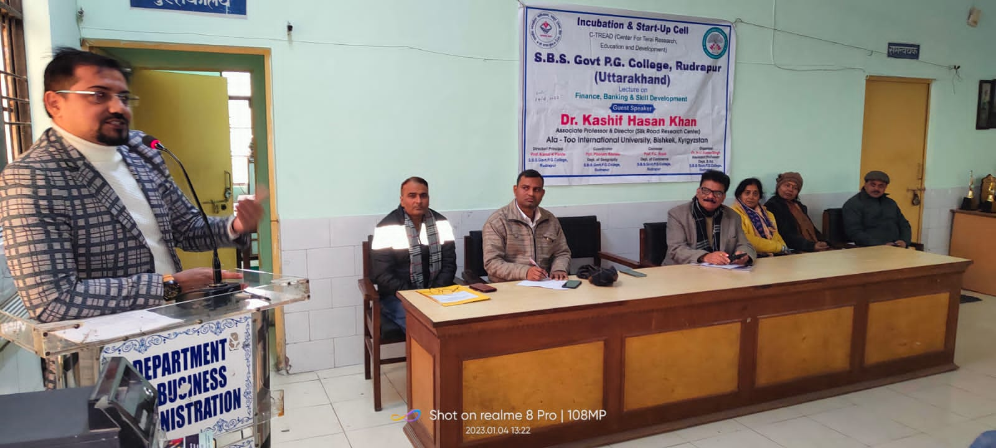
On January 4, 2023., An International Lecture on Finance, Banking & Skill Development

Slide 36
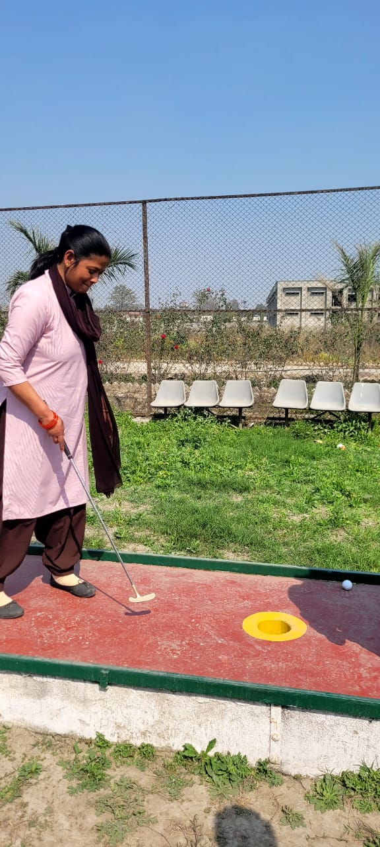

Sport Activity Mini golf playing

Slide 37

4th March,2023 Holi Celebration
On 4March, 2023 B.Ed. Department organized Fagotsav with Holi Colors (Kumauni Sanskriti ki ak Jhalak) Program on the occasion of Holi the motive of holi celebration is to promote to our culture and tell the importance and moral of Holi celebration to our future coming teachers.

Slide 38

4th March,2023 Holi Celebration

Slide 39



Slide 40


On March 8, 2023, A program of International Women Day celebrated

Slide 41


On March 16, 17&18, 2023., A three days workshop on ‘Hands-On- Training On Arts& Crafts for Developing Entrepreneurial Skills’
On March 16, 17&18, 2023, a three days workshop on ‘Hands-On- Training On Arts& Crafts for Developing Entrepreneurial Skills’ was organized by the Science Popularization Cells in collaboration with Department of Education (B.Ed.) and Pedilite Manufacturing Company where more than 86 students participated in creative and innovative training under the guidance of Smt. Vandana Agrwal Madam who joined as a chief trainer from Pedilite Manufacturing Company.

Slide 42


On March 16, 17&18, 2023., A three days workshop on ‘Hands-On- Training On Arts& Crafts for Developing Entrepreneurial Skills’

Slide 43

March 24, 2023., A program of Aparajita sponsored by the Amar Ujala under Career Counseling for women empowerment through education
On March 24, 2023, a program of Aparajita sponsored by the Amar Ujala under career counseling for women empowerment through education was organized in collaboration of Department of Education where all the girls students and female faculty of the institution including Principal Sir and other supporting staff of Amar Ujala News participated very warmly highlighting the situation of women in the contemporary society of our country.

Slide 44


March 24, 2023., A program of Aparajita sponsored by the Amar Ujala under Career Counseling for women empowerment through education

